Slide 1

Gradient Descent
Ahmed Tolba
Ahmed Elmasry

Slide 2
AGENDA
01
02
03
04
Batch Gradient Descent
Gradient Descent
Stochastic Gradient Descent
Mini Batch Gradient Descent

Slide 3
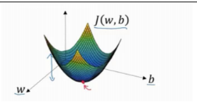
What is the meaning of Gradient descent?
Gradient Descent
Gradient descent is a optimization algorithm for finding a global minimum of a differentiable function .

Slide 4

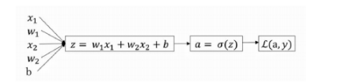
Gradient Descent
Revision

Slide 5
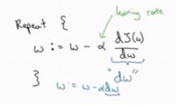
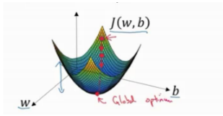
How does gradient descent work?
Gradient Descent
You start by defining the initial parameter's values and from there gradient descent uses calculus to iteratively adjust the values so they minimize the given cost-function.
by iteratively moving in the direction of steepest descent

Slide 6
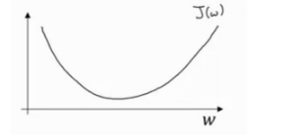
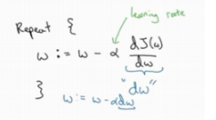
Gradient Descent
We ignore the value of the b and consider that the influencing factor is the w
Notes :
Alpha is Learning rate
W is weights

Slide 7
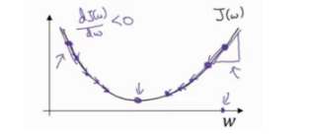
Gradient Descent
1 - We consider that the first point on the right is the first value that appeared for the cost function, and we want to reduce it, so we must differentiate the values of the weights and subtract it from the previous values, because the slope is positive and do not forget that our goal is to reach zero.
2 - Whereas, if the slope is negative, it must be added to increase the citrate values and approach them to zero

Slide 8
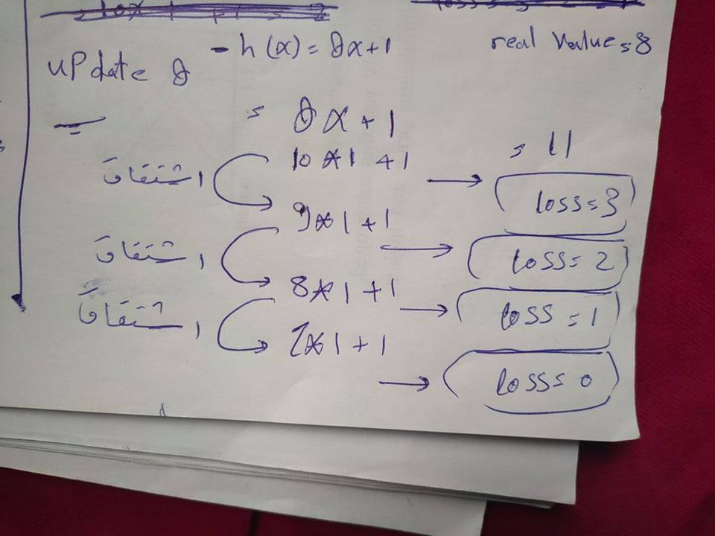
Examble

Slide 9
The Gradient Descent has proven itself in machine learning models. But when dealing with big data you have to turn to
1 – BGD
2 – SGD
3 – MBGD

Slide 10
BGD
How does Batch gradient descent work?
( As a all )
In Batch Gradient Descent, all the training data is taken into consideration to take a single step.
1 - Every Step Apply it’s Function . (note one Step meaning Training All Data !! )

Slide 11
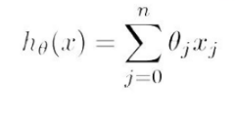
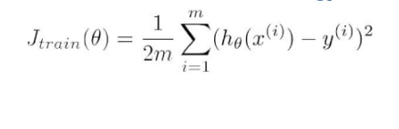
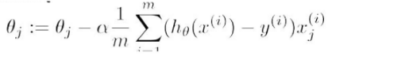
BGD
How does Batch gradient descent work?
Predicted Value
Cost Function
The derivation of the function

Slide 12

Example
H(x) = theta0*X0 + theta1*x1 + theta2*x2 +…….thetaN * Xn
area
Num-room
price
1 – predict The Value for All Data
2 - Calculate cost Function
3 – repeat if you want ( change Parameter )

Slide 13
BGD
Advantage of BGD
more accurate
Disadvantage of BGD
1 - Time consuming because it takes a lot of time in processing ( Summation)
2 - Expensive because it needs devices with superior capabilities to deal with it

Slide 14
SGD
How does Stochastic gradient descent work?
Stochastic gradient descent (often abbreviated SGD) is an iterative method for optimizing an objective function with suitable smoothness properties (e.g. differentiable or sub differentiable ). It can be regarded as a stochastic approximation of gradient descent optimization.
In Stochastic Gradient Descent, only one line of training data is taken into consideration to take a single step to update weights .

Slide 15


SGD
Predicted Value
Cost Function
The derivation of the function
Note that there is no Summation sign here because it is performed from line by line

Slide 16
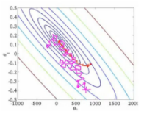
SGD
Advantages of Stochastic Gradient Descent
Disadvantages of Stochastic Gradient Descent
It is easier to fit in the memory due to a single training example being processed by the network.
It is computationally fast as only one sample is processed at a time.
For larger datasets, it can converge faster as it causes updates to the parameters more frequently.
Due to frequent updates, the steps taken towards the minima are very noisy. This can often lean the gradient descent into other directions.
Also, due to noisy steps, it may take longer to achieve convergence to the minima of the loss function.

Slide 17
Example
SGD
H(x) = theta0*X0 + theta1*x1 + theta2*x2 +…….thetaN * Xn
area
Num-room
price
1 – predict The Value for Data line by line
2 – ( change Parameter )
3 - Calculate cost Function

Slide 18
MBGD
Mix between BGD , SGD
Mini-batch gradient descent is a variation of the gradient descent algorithm that splits the training dataset into small batches that are used to calculate model error and update model coefficients. ... It is the most common implementation of gradient descent used in the field of deep learning

Slide 19
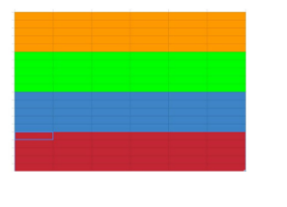
MBGD
How does Mini Batch gradient descent work?
It divides the data into several parts, according to the size of the data and applying Stochastic for every section

Slide 20
ADVANTAGES
mix between SGD , BGD so it extend from them.
1-Easily fits in the memory.
2-It is computationally efficient.
3 - fast

Slide 21
DISADVANTAGES
Sometimes a stable error gradient can lead to a local minima and unlike stochastic gradient descent no noisy steps are there to help get out of the local minima.
The entire training set can be too large to process in the memory due to which additional memory might be needed.

Slide 22
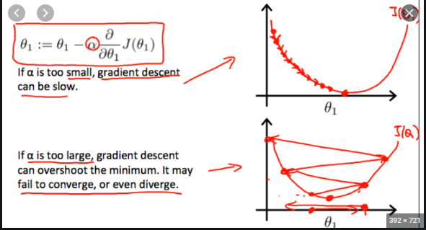
MBGD
How to choose between SGD , BGD , MBGD
Mostly it depends on the alpha value,
when you use alpha is a large number,
the steps will become large and inaccurate
Likewise, if you use a small alpha number,
the steps will be small but more accurate

Slide 23
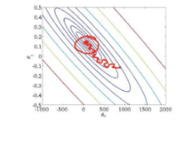

so, what is the solution ?
By Using This Equation ☺

Slide 24
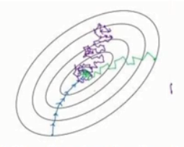
Comparison
BGD
SGD
MBGD

Slide 25
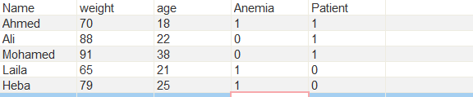
Practical example
We have some data to find out if they are infected or not
We can extract some information from the data
M = 5 ( Len Of Data )
N = 3 ( Future name )
Number of theta = 4 ( N+1)

Slide 26
Practical example
1 - Predicted Value is H(x) = theta0*X0 + theta1*x1 + theta2*x2 + theta3*x3
2 – Cost Function ( real Value – h(x) )
3 – Update weights

Slide 27



On its first Iteration,
it creates theta values as random values
Theta matrix is : 4 * 1
X0 = 1
X matrix is : 5 * 4
X Transpose = 4 *5
Y mat y marix is 5 *1

Slide 28

when multiply X * Theat
X Theta
5 * 4 * 4 * 1 = 5 * 1
Then Subtract X * theta From Y
X * theta - Y = output
5 * 1 - 5*1 = 5 * 1
Then
X Transpose * output new_output
4 * 5 * 5 * 1 = 4 * 1
Alpha = ………
M = 5
Subtract theta from new_output after multiply alpha / m
Repeat this process until you get the perfect values Of Theat And then use
hΘ(x) = g ( Θ0 + Θ1x1 + Θ2x2 + Θ3x3 )

Slide 29
Thanks

